Slide 1

Simulation Project
Team B
Improve Throughput of the Main Road
Hannoversche Str. / Diesdorfer / Ummendorfer Str.
Milestone 3
Presented by
Rahul Pothanchery
11.05.2023
Simulation Project - Team B
1

Slide 2
Overview
Project Schedule
Events
Assumptions
Petrinet
Data Required
Experiments
Quantities used for results
Lessons Learned
11.05.2023
Simulation Project - Team B
2

Slide 3
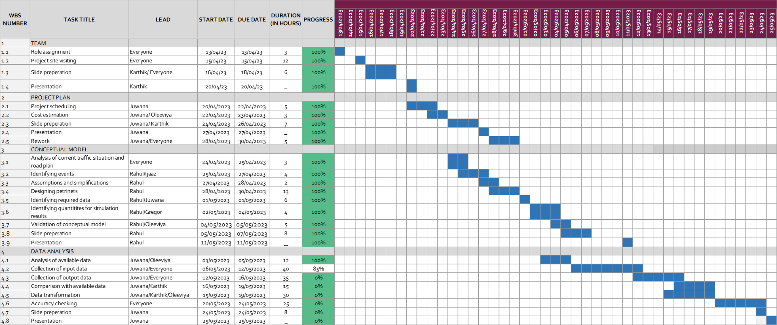
Project Schedule
11.05.2023
Simulation Project - Team B
3

Slide 4
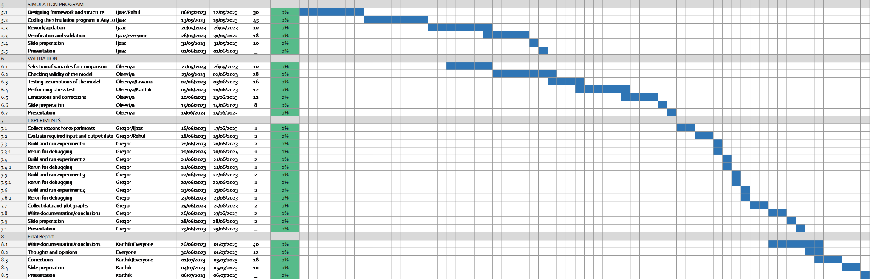
Project Schedule (Contd.)
11.05.2023
Simulation Project - Team B
4

Slide 5

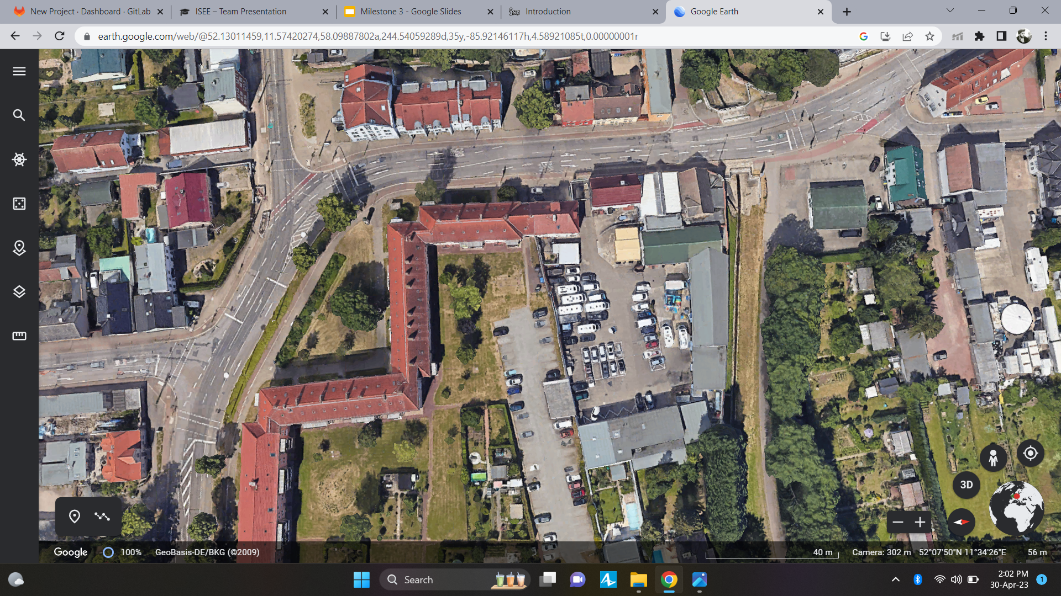
System
Ummendorfer
Kümmelsberg
Hannoversche Straße
Diesdorfer Grasweg
Große Diesdorfer
11.05.2023
Simulation Project - Team B
5

Slide 6
Events
Arrival of vehicles/pedestrians/trams
Traffic signals changing colors
Vehicles/pedestrians/trams moving to the next place
Vehicles/pedestrians/tram exiting the system
11.05.2023
Simulation Project - Team B
6

Slide 7
Assumptions
Pedestrians crossings functioning on timings
No vehicle movement to and from Hemsdorfer straße
Traffic lights functioning based on fixed timings
Everybody obeys the rules
11.05.2023
Simulation Project - Team B
7

Slide 8
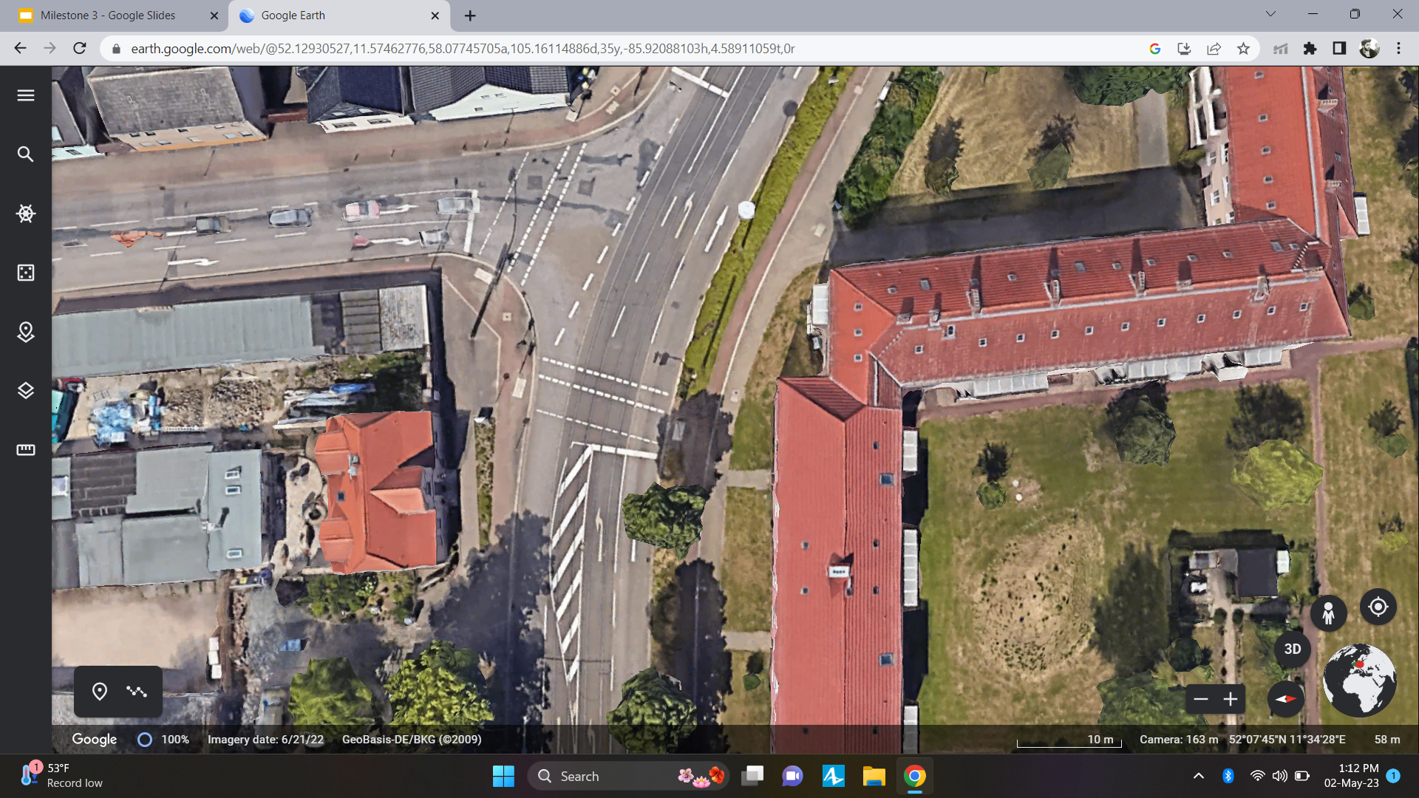
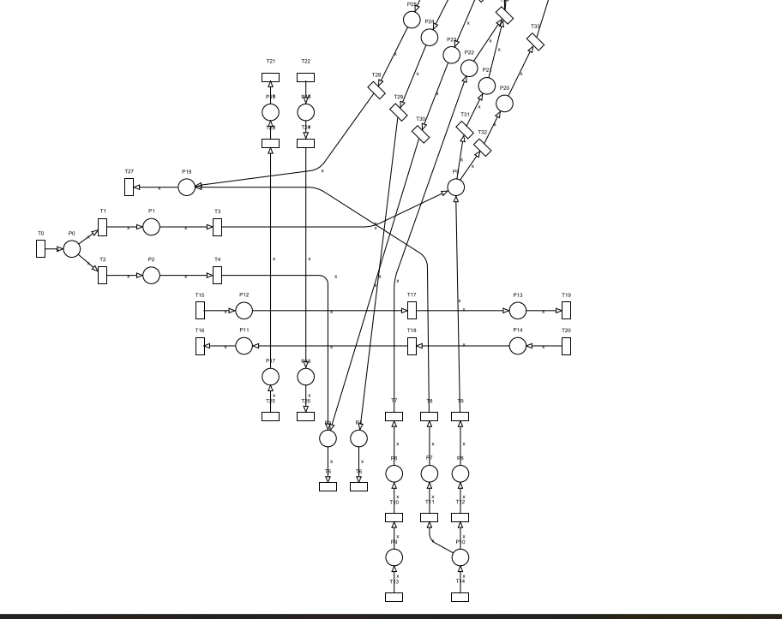
Petrinet - Große Diesdorfer Straße and Diesdorfer Grasweg
Diesdorfer Grasweg
Große Diesdorfer Str.
11.05.2023
Simulation Project - Team B
8

Slide 9
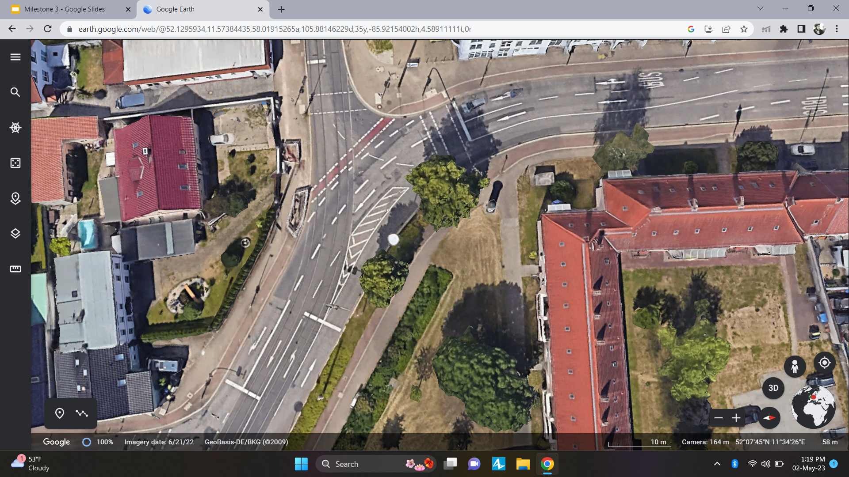
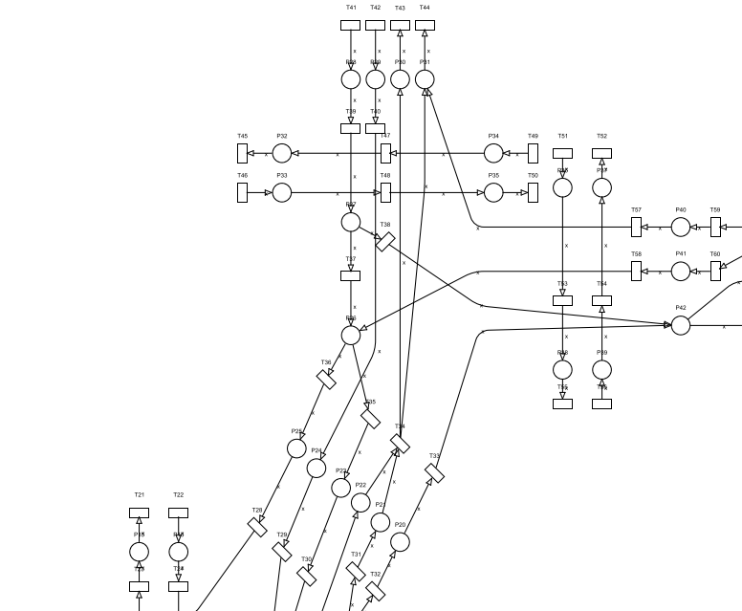
Petrinet - Hannoversche Straße and Ummendorfer Straße
Ummendorfer Str
Hannoversche Str
11.05.2023
Simulation Project - Team B
9

Slide 10
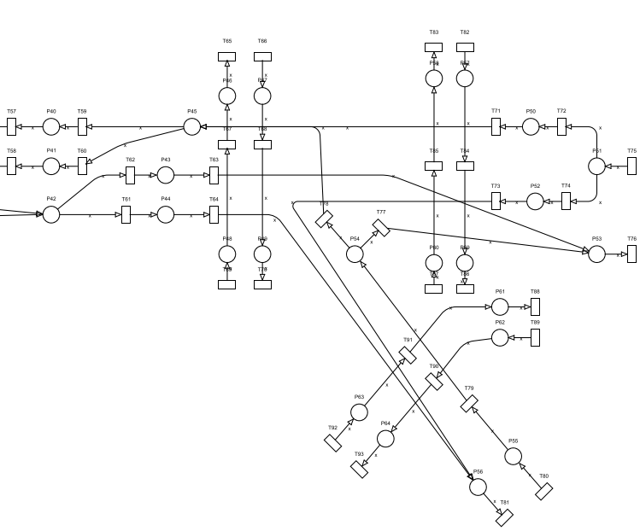
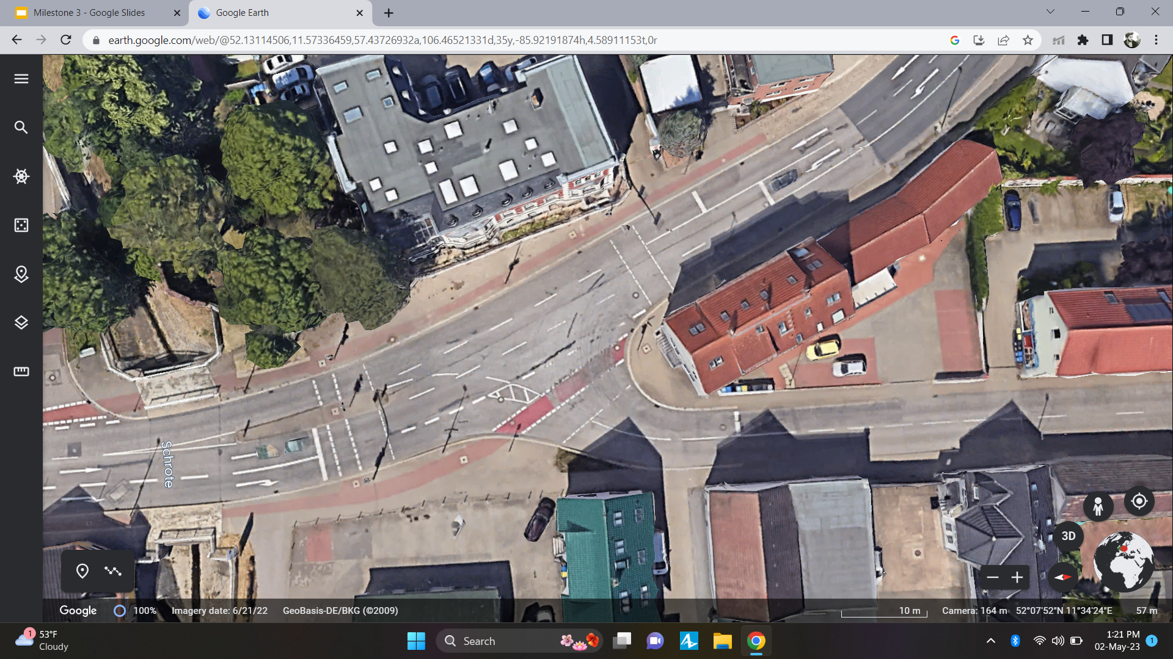
Petrinet - Hannoversche Straße and Kümmelsberg
Kümmelsberg
Hannoversche Str
11.05.2023
Simulation Project - Team B
10

Slide 11
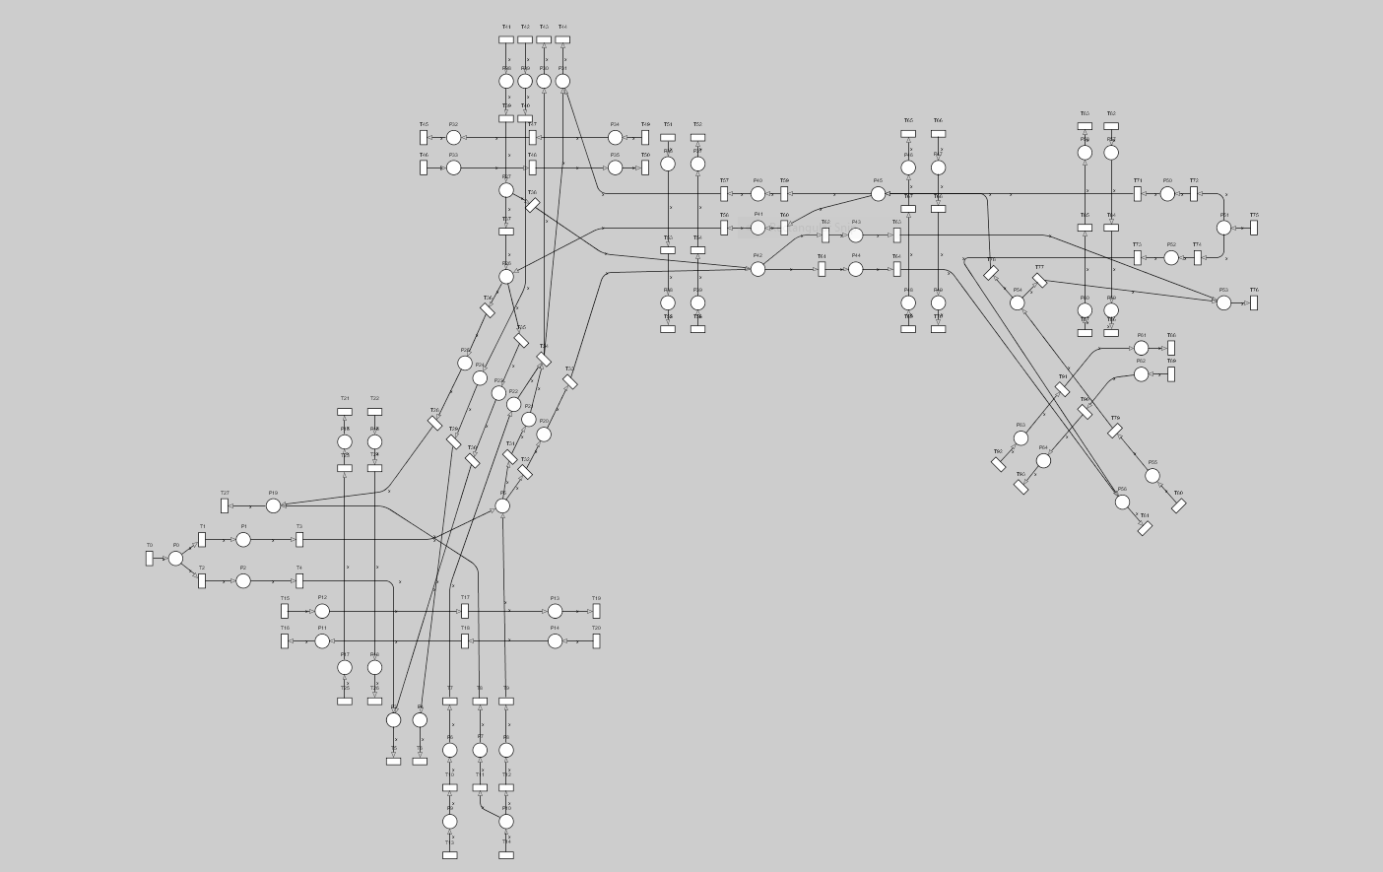
11.05.2023
Simulation Project - Team B
11

Slide 12
Primary events
Arrival of vehicles/pedestrians/trams - stochastic
Traffic signals changing colors - deterministic
Secondary events
Vehicles/pedestrians/trams moving to the next place - stochastic
Vehicles/pedestrians/trams exiting the system - stochastic
11.05.2023
Simulation Project - Team B
12

Slide 13
Data required
Inter-arrival time of vehicles/trams/pedestrians on all nodes
Average length of vehicles
Capacities of places
Probability of vehicles turning to different lanes
Average no. of vehicles exiting the nodes
Average time spent by vehicles in the system
11.05.2023
Simulation Project - Team B
13

Slide 14
Quantities used as simulation results
Average no. of vehicles entering and exiting the nodes per unit time
Average total time spent by vehicles in the system
11.05.2023
Simulation Project - Team B
14

Slide 15
Experiments
Removing a traffic signal
Combining the tram line into one
Subway for pedestrians
Optimizing the traffic signals
11.05.2023
Simulation Project - Team B
15

Slide 16
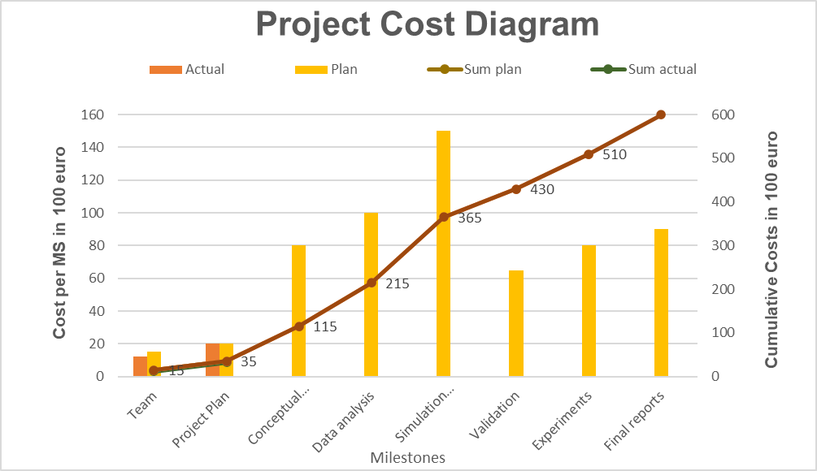
Project Cost
11.05.2023
Simulation Project - Team B
16

Slide 17
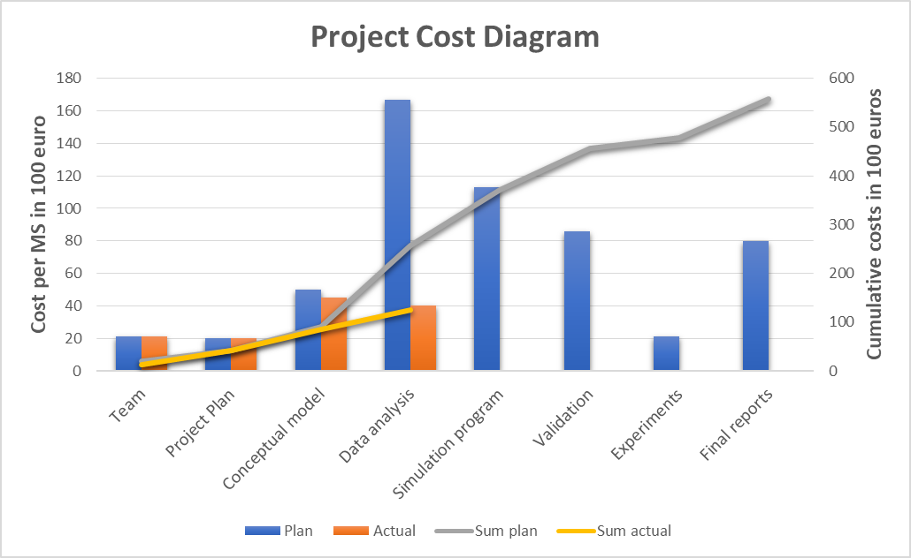
Revised Project Cost
11.05.2023
Simulation Project - Team B
17

Slide 18
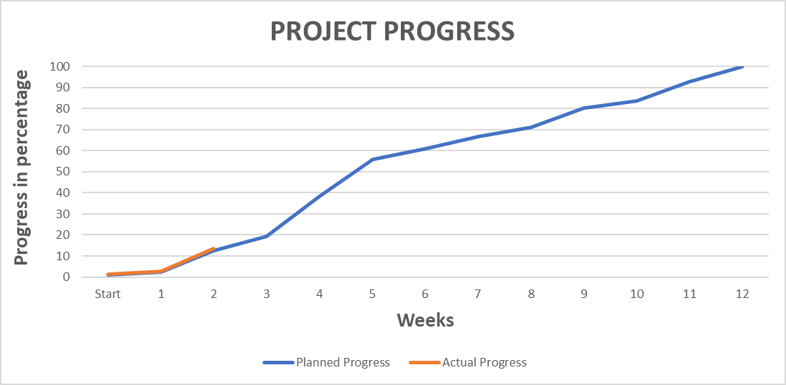
Project Progress
11.05.2023
Simulation Project - Team B
18

Slide 19
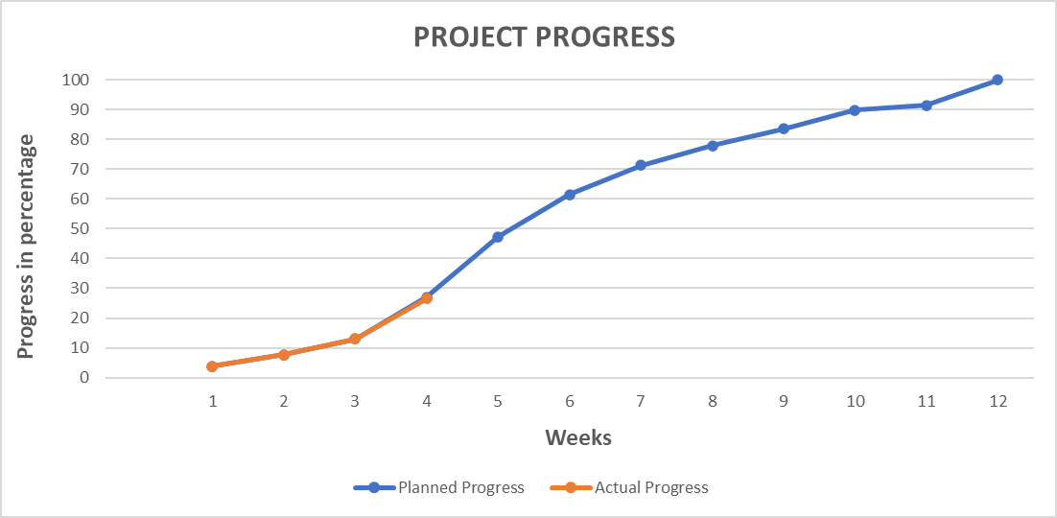
Revised Project Progress
11.05.2023
Simulation Project - Team B
19

Slide 20
Lessons Learned
Model a real life system
Model should be flexible
Stepping stone for the project
Teamwork improves quality
11.05.2023
Simulation Project - Team B
20

Slide 21
Thank You
Questions?
11.05.2023
Simulation Project - Team B
21

